Slide 1
Module 2: Exploring and Visualizing Data
Nikhil D Jonathan, July 2026

Slide 2
Importance and Characteristics of Descriptive Data
Exploratory Analysis using Python for data pre-processing – Distributions and Outliers
Visualizing using Seaborn and Matplotlib
Classroom Assignment where questions are asked on a dataset to make students perform EDA

Slide 3
Exploratory Data Analysis
It’s the foundation for successful algorithm development.
Descriptive Analytics is a key component of EDA.
It includes Univariate and Multivariate graphical and non-graphical inferences/insights for business intelligence.

Slide 4
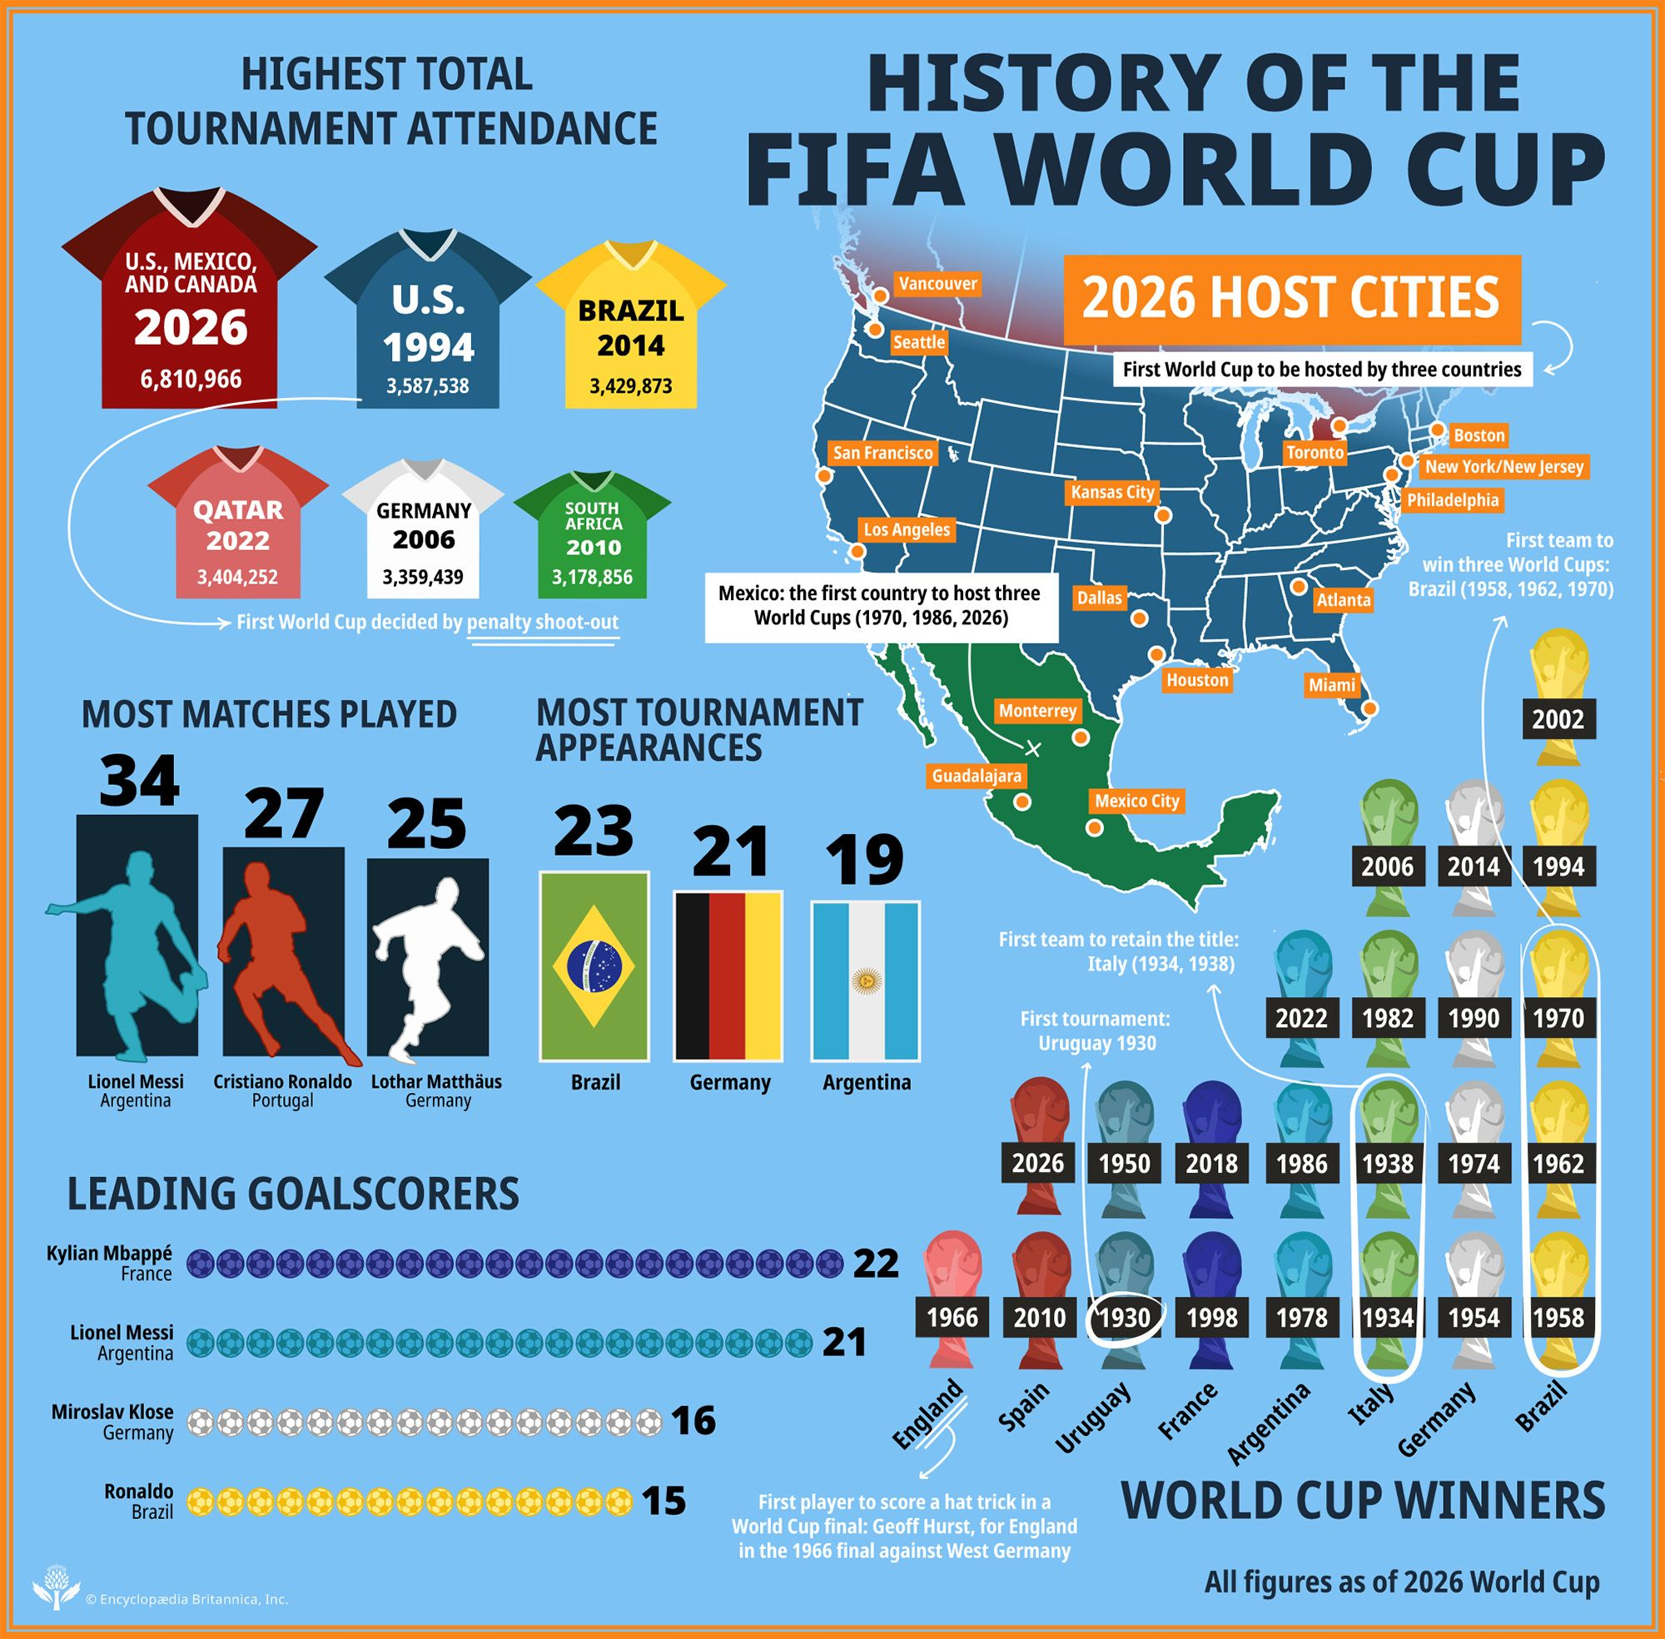

Slide 5
What is Pandas?
It is an open-source, Berkley Software Distribution (BSD) –licensed library that provides high performance, easy-to-use data structures and data analysis tools for the python programming language.
It is extremely useful for exploration and preparation.
We will be using ‘Panda’s data-frames’ extensively through this course.

Slide 6
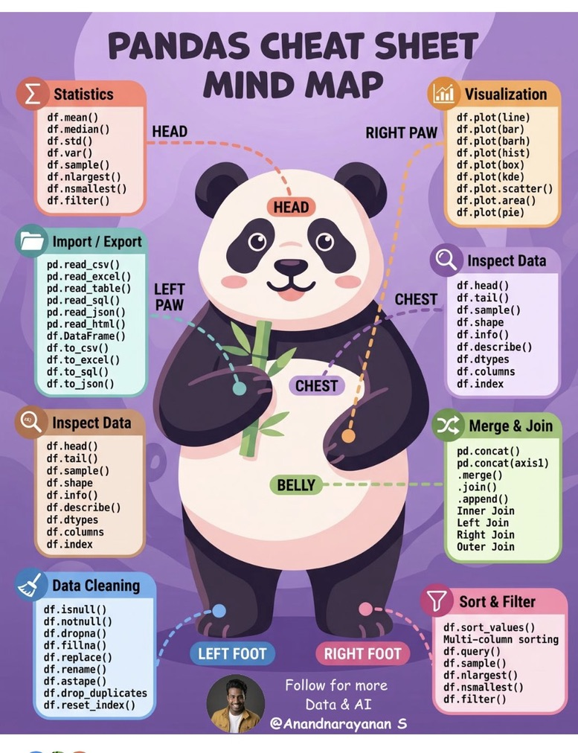

Slide 7
Three parts of Exploratory Analysis:
Working with Data frames
Handling Missing Values
Exploration using data Visualization

Slide 8
Working with Data frames:
Loading a dataset into a Pandas data frame.
Displaying the first few records of the data frame
Finding the summary of data frame
Slicing and Indexing of the data frame
Value Counts and Cross-tabulation
Sorting the Data frame by column values
Creating New Columns
Grouping and Aggregating
Joining Data frames
Re-naming Columns
Applying Operations to Multiple Columns
Filtering Records Based on Conditions
Removing a column or row from a dataset

Slide 9
Case-let: Bidding for the next world cup 2030 media rights, is it worth while?
On 19 July 2026, Spain beat Argentina 1–0 in East Rutherford, New Jersey, and the largest World Cup ever played — 48 teams, 104 matches, three host countries — was over.
You work at a sports-marketing agency in Bengaluru. Your client is a broadcaster preparing its bid for Indian media rights to the next tournament cycle.
The bid team has one question that keeps coming back in meetings: what actually holds an audience through a football match?
Advertising is sold by the minute, and nobody wants to pay premium rates for minutes when nothing happens.
Your inbox this morning contains three CSV files, pulled from a public match-results archive: every match, every goal with the minute it was scored, and every penalty shoot-out.
Nothing has been analysed. There is no dashboard, no report, no summary — the tournament ended five days ago.
The senior partner wants one page by Friday. Not a model. Not a forecast. One page of facts a bid team can defend at the board room.
Your first task is smaller than that. Before you can write a single sentence, you have to find out what is actually in these files.

Slide 10
Reference Datasets/Code/Cases
https://github.com/martj42/international_results/tree/master
https://www.kaggle.com/code/doctornikhildj/eda-practice-xime-2026/edit
https://archive.ics.uci.edu/dataset/9/auto+mpg

Slide 11
Data Lineage
It is Vital to understand how the data were generated and collected. Collectively, we call this information the lineage of the data.
Keeping tract of a dataset:
Who or what do the data represent? Are the data representative of the population we are interested in?
Where are the data stored? Are we following privacy best practices?
When were the data collected? Has something fundamentally changed since the data were collected?

Slide 12
Handling Missing Data
Identify if the data is missing in a systematic way or missing completely at random (MCAR)
If MCAR , ignoring the rows will produce valid results.
Examples:
1. All the people above a certain height failed to report their Body Mass Index (BMI)
2.Out of a class of 50, 40 reported their BMI and 10 did not.

Slide 13
Data Visualization using Dashboards on Databricks

Slide 14
“Pricing in the Sparkle: A Diamond Marketplace”
You have joined the analytics team of an online diamond marketplace – “United States Diamond Exchange (UDE)”.
The pricing team keeps arguing about what a diamond is really worth — some swear by the cut and clarity, others by size.
Before the next pricing review, your manager hands you a sample of 260 diamonds and a clarity reference sheet, and asks for a quick, honest data snapshot: what drives price, and do the “obvious” rules of thumb actually hold?

Slide 15
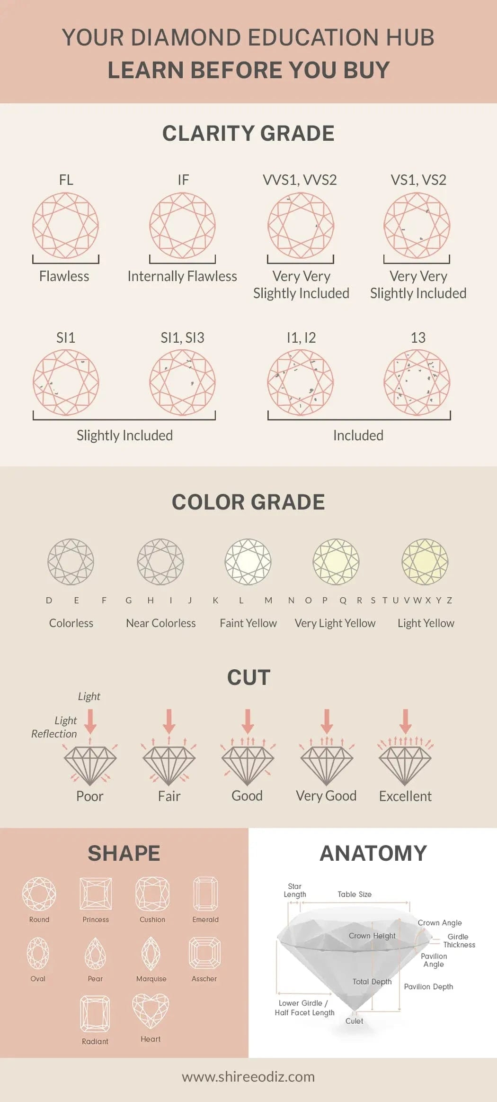
https://www.shireeodiz.com/blogs/articles/diamond-color-scale-10-essential-tips-before-buying?srsltid=AfmBOoq_J96TG_fDATr8r8nOwpVUZDauXJZlPVutpon9WA5ZvPwp4nQx

